Slide 1
Rafsanjan Analysis

Slide 2
Review
Step1. Data collection
Step2. Data preparation and cleaning
Step3. Data visualization
Step4. Data storage
Step5. Roadmap

Slide 3
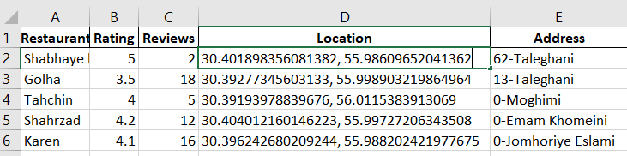
Step1. Data collection
Google maps:
Searched for the restaurants in Rafsanjan on Google maps.
Entered the data about restaurants into an Excel file named “restaurants_data”
Features like Name, Rating, Review, Location, Address.

Slide 4
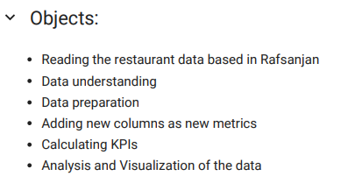
Step2. Data preparation and cleaning
Python:
Python as a strong language for data analysis was used for both data preparation and data analysis.
Results:
The dataset has 166 rows and 4 columns.
We have 113 rows with Rating and Reviews columns being filled.
The average of the Ratings and Reviews is 4.10, and 6.15, respectively.
The minimum of Ratings and Reviews is 1, and 1, respectively.
The maximum of Ratings and Reviews is 5, and 100, respectively.
We have 53 rows with NULL values to be removed.
There are no duplicated records even with duplicated names.
Added a new column as a metric named “Customer Satisfaction Score”.
Added a new column named “Street” that was obtained from the Address column for later analysis.
The average rating for Rafsanjan is 4.11.
The Percentage of Positive Reviews for Rafsanjan is 65.49%.

Slide 5
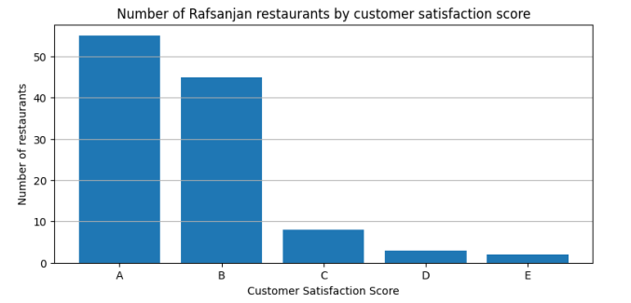
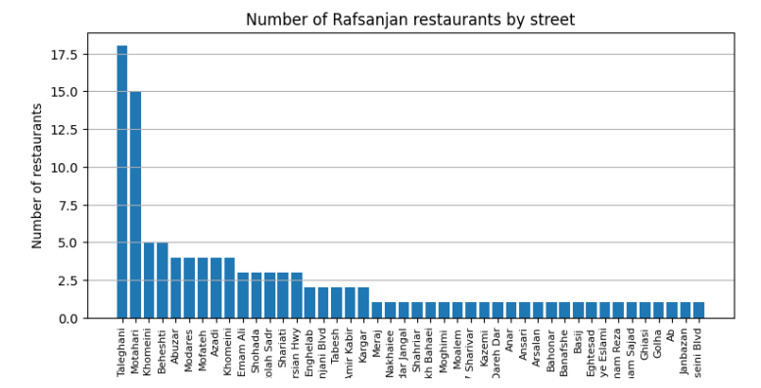
Step3. Data visualization
5
A. Python visualizations

Slide 6
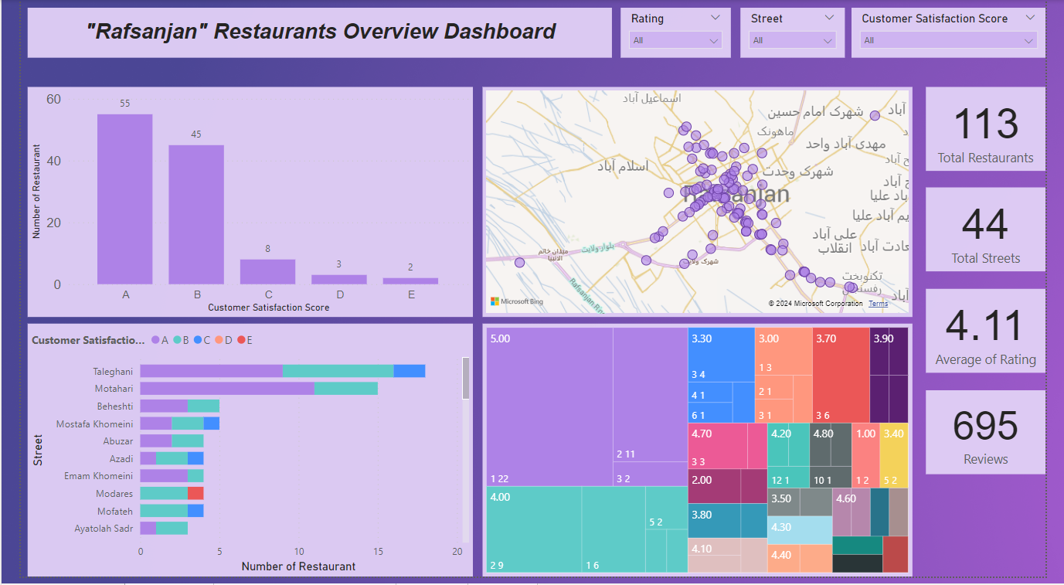
Step3. Data visualization
6
B. PowerBI visualizations
"Rafsanjan" Restaurants Overview Dashboard

Slide 7
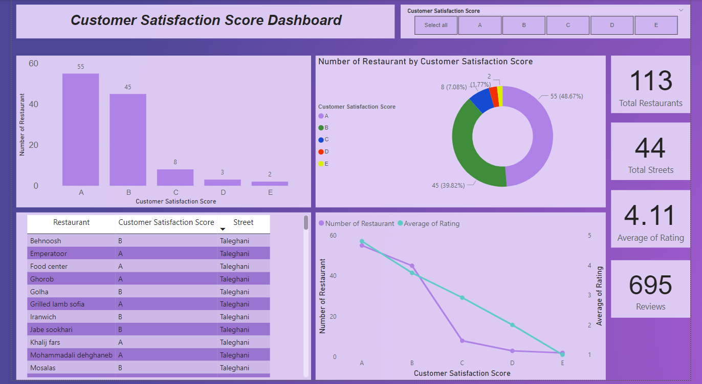
Step3. Data visualization
B. PowerBI visualizations
Customer Satisfaction Score Dashboard

Slide 8
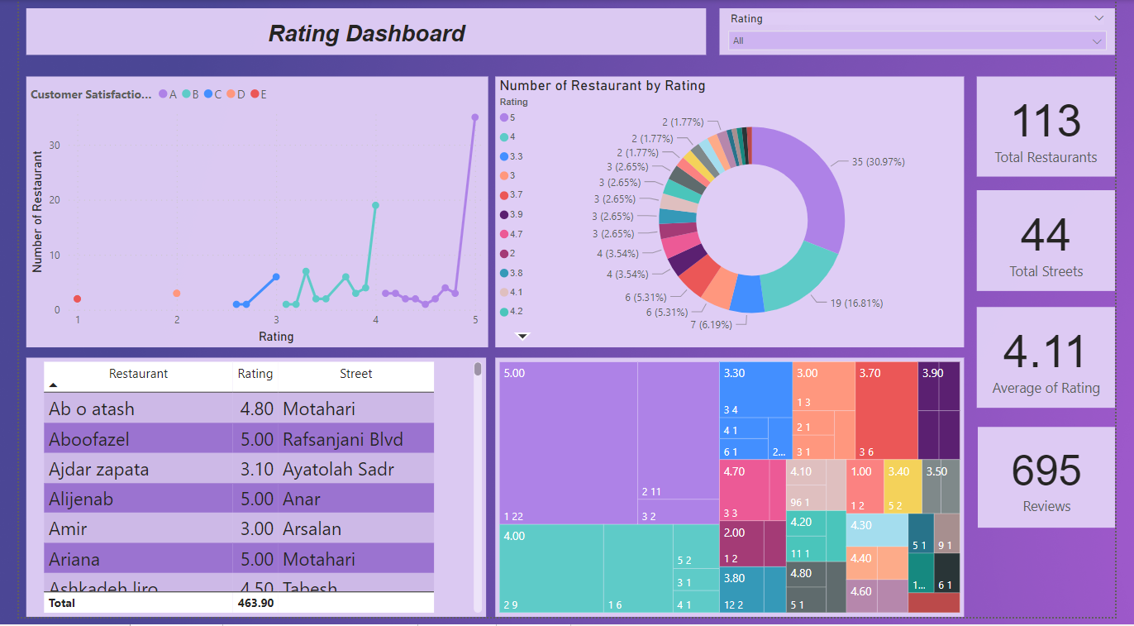
Step3. Data visualization
B. PowerBI visualizations
Rating Dashboard

Slide 9
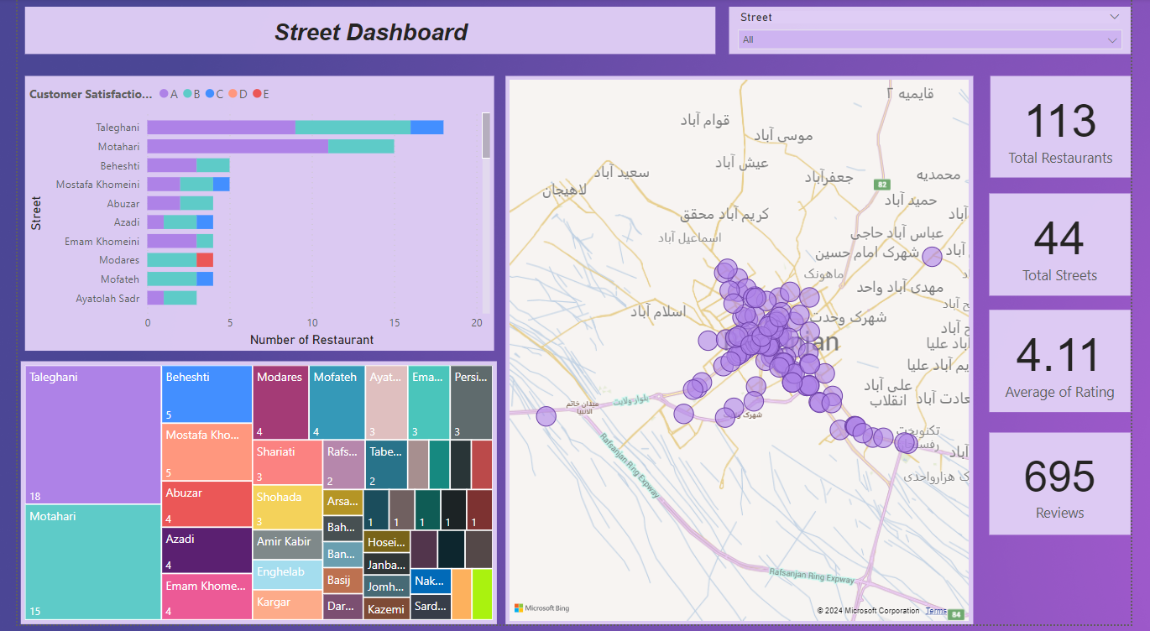
Step3. Data visualization
B. PowerBI visualizations
Street Dashboard

Slide 10
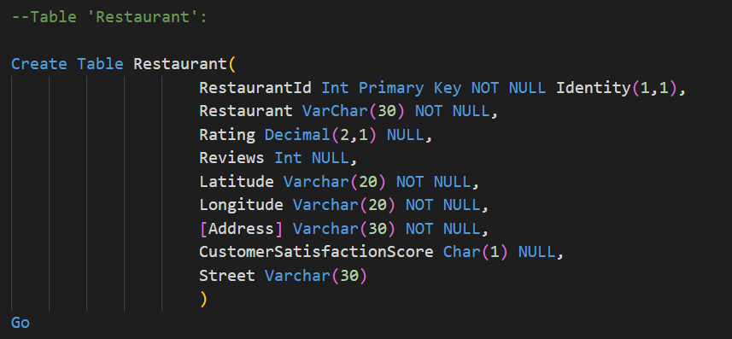
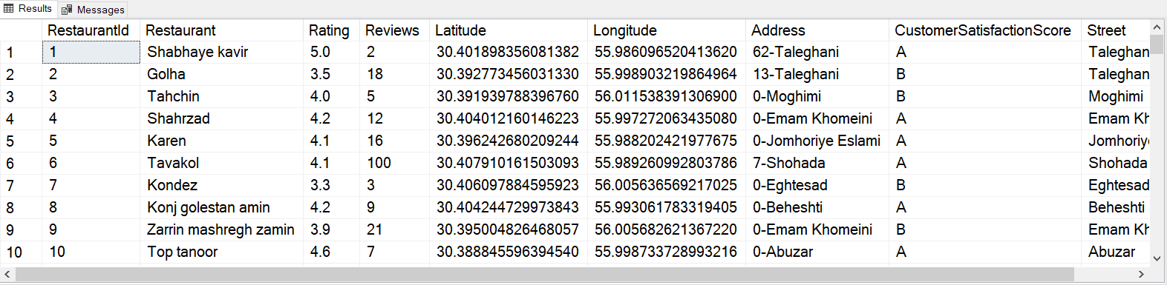
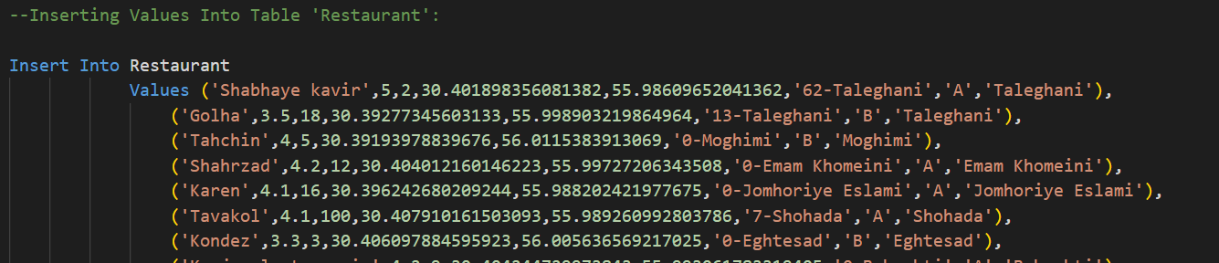
Step4. Data storage
Microsoft SQL Server:
Created a database named dbRafsanjan.
Created a table named Restaurant.
All 113 records were entered into the table.

Slide 11
Step5. Roadmap
Solutions
Starting with the restaurants with “A” or “B” scores.
Considering the Review number as some of the scores seem not to be valid.
Monitoring the Average Rating KPI while growing the network of new restaurants as the initial value was 4.11 and trying to increase this value.
Monitoring the Positive Reviews Percentage KPI as the initial value was 65.49% and trying to increase this value.
Streets like Taleghani and Motahari seem to be a good choice to start activities as they have 18 and 15 restaurants respectively.

